Slide 1
Angular
Curs 1
Pass: CursProgramare2016

Slide 2



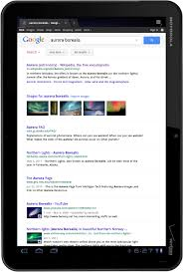
Web Applications
IE, Chrome, FireFox, Safari, Opera
Request
Web Resource
HTML, PDF, JSON, JS ...
protocol
Ce este o aplicatie web?
HTTP Transaction
Web Client
User Agent
Response
Doesn’t change
Static or Dynamic
Web Application
Generated on the fly
Web Server
Ex Protocols:
Stateless
URL
HTTP
FTP
http://www.google.com:8080/2017/07/up-and-running-trainning.html
TCP
Altele: SMTP, POP, XRP, Bitcoin Protocol, etc

Slide 3
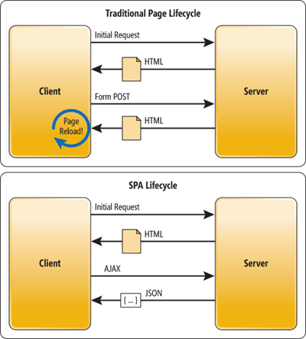
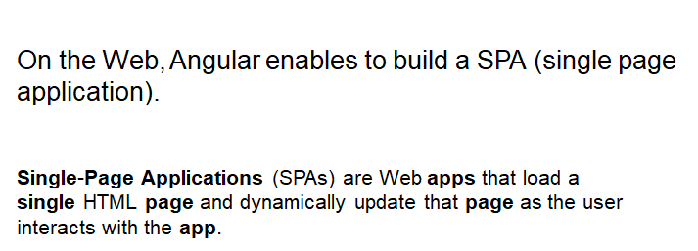
ANGULAR

Slide 4
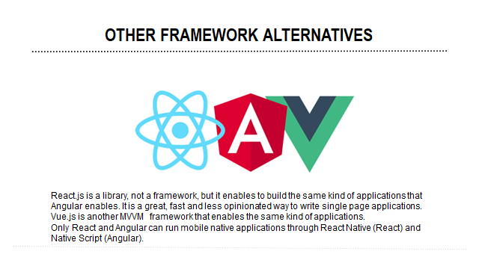

Slide 5
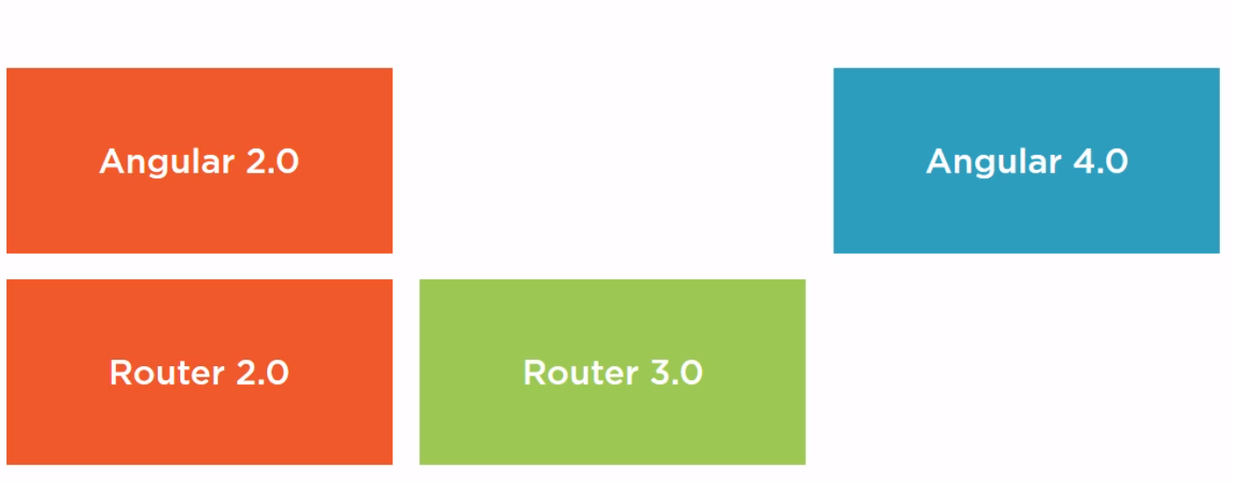
About Versioning...
...

Slide 6
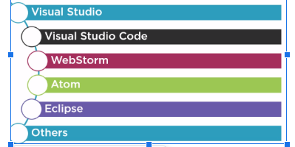
IDE (Integrated Development Environment)

Slide 7
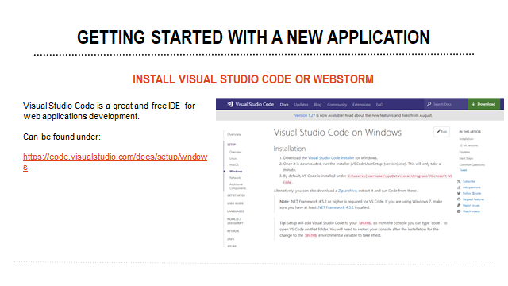

Slide 8
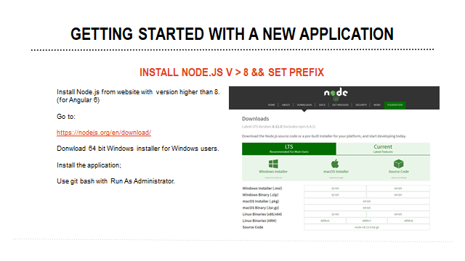

Slide 9
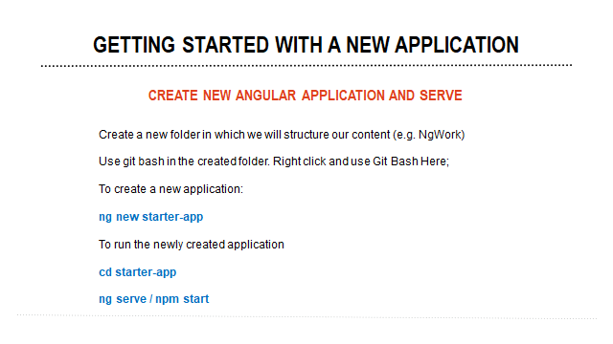

Slide 10
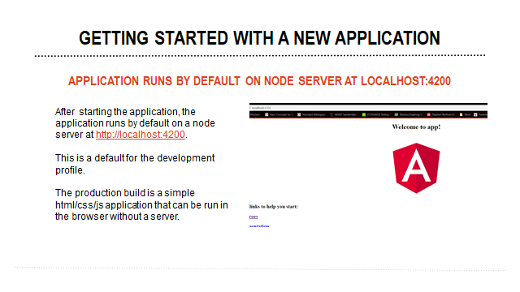

Slide 11
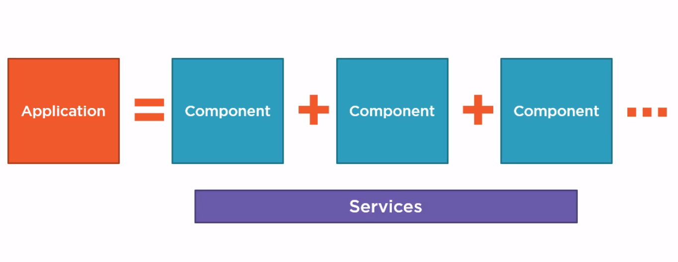
Anatomy of the Angular Application

Slide 12
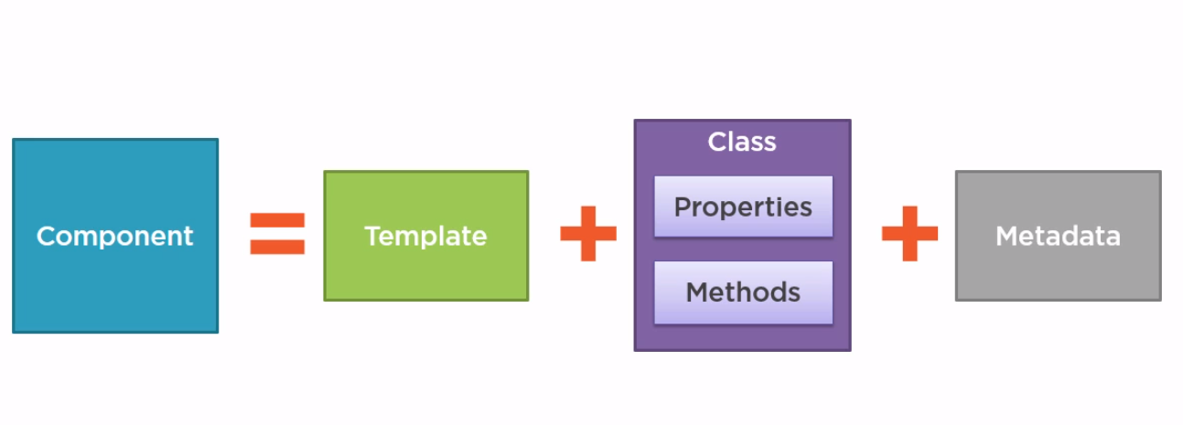
What is a Component?

